Slide 1
RUNGTA COLLEGE OF DENTAL SCIENCES & RESEARCH
TERMINOLOGIES
IN FIXED PROSTHODONTICS
Dr. Jagadeesh H G Professor & HOD
DEPARTMENT OF PROSTHODONTICS AND CROWN & BRIDGE

Slide 2
Specific learning Objectives
Core areas | Domain | Category
Introduction Definition | Cognitive | Must Know
Terminologies | Cognitive | Must Know
Conclusion Take home message | Affective | Desired to know

Slide 3
Table of Contents
Introduction
Definition
Terminologies
Conclusion
Take Home Message

Slide 4
PROSTHODONTICS
The branch of dentistry pertaining to the restoration & maintenance of oral function, comfort, appearance & health of the patient by the restoration of natural teeth & / or the replacement of missing teeth & contiguous oral and maxillofacial tissue with the artificial substitute.

Slide 5
Prosthesis
An Artificial replacement of an absent part of the human body

Slide 6
Removable Prosthodontics Complete Denture Removable Partial Denture
Fixed Prosthodontics
Fixed partial denture
Implant denture
Maxillofacial Prosthodontics

Slide 7
Fixed Prosthodontics:
It is that branch of prosthodontics concerned with the replacement & or restoration of teeth or both by artificial substitutes that are not readily removable from the mouth

Slide 8
Fixed Prosthodontics:
is a partial denture that is luted or otherwise securely retained to natural teeth, tooth roots and/or dental implant abutments that furnish the primary support for the prosthesis.

Slide 9
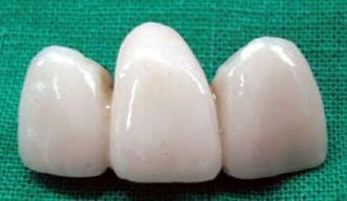

Slide 10
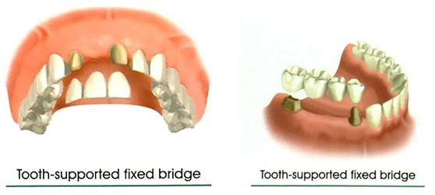
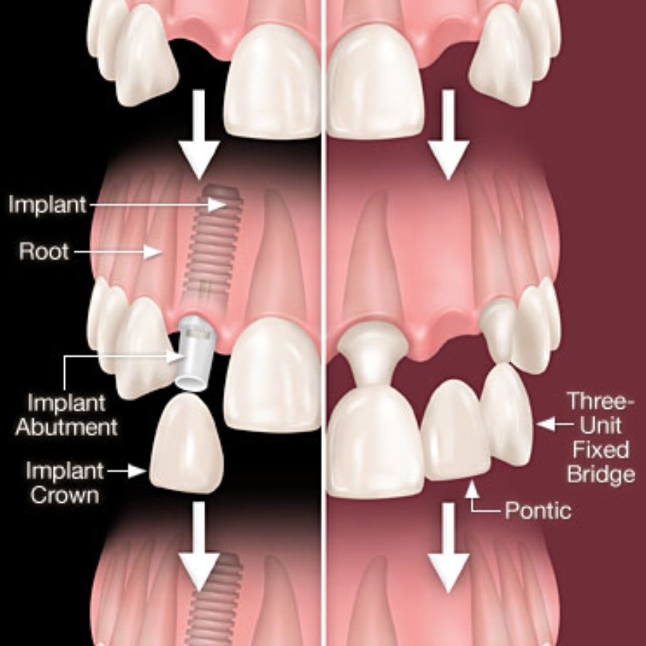

Slide 11
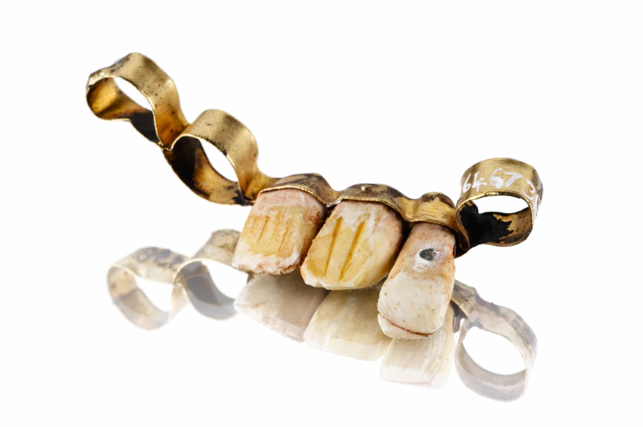
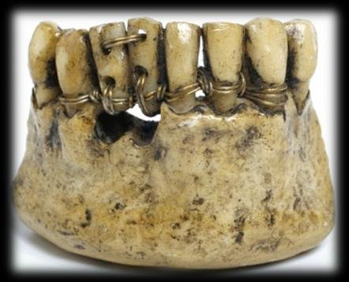
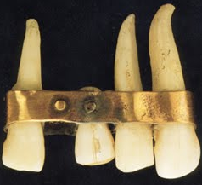
History

Slide 12
PARTS OF A FIXED PARTIAL DENTURE
Pontic
Retainer
Connector
Edentulous Ridge

Slide 13
PONTIC
An artificial teeth on a fixed partial denture that replaces missing natural teeth, restores it’s function and usually fills the space previously filled by the natural teeth. ( GPT 9 )
Connectors
That portion of a FPD that unites the retainers and the pontic

Slide 14
RETAINER
It is that part of FPD that unites the abutment(s) to the reminder of the restorations or the restoration that are cemented onto the prepared tooth / abutment. It replaces either external/internal surface of the crown, part of the crown or the complete crown.

Slide 15
Abutment
A tooth, a portion of a tooth, or that portion of dental implant that serves to support & or retain a prosthesis.

Slide 16
CROWN
It is a cemented extra coronal restoration that covers as veneers on the outer surface of the clinical crown.
Ante’s Law: Abutment teeth should have a combined pericemental area equal to or greater than the tooth/teeth to be replaced

Slide 17
Indications: for FPD
Non vital teeth
Carious exposure
Maintain integrity of the arch.
Occlusal Harmony
Less of contact point

Slide 18
Contraindications:
Short clinical crowns.
Tapered crowns.
Nor below 12 years and above 55 years.
High DMF index.
Poor Periodontal status.
Poor oral hygiene.
Bruxism, TMJ dysfunction, over jet.
Excessive resorption of ridge.
Large edentulous space.
Tilting of abutment more than 30^{0.}
If number of posterior teeth distal to edentulous area.
Hypersensitivity during crown preparation.

Slide 19
CLASSIFICATION OF RETAINERS
A.
Extra Coronal Retainers.
Anterior – Jacket crown.
- ¾ PVC.
Posterior – Full veneer crowns.
- ⅘ PVC.
- ⅞ PVC.
- ½ Crowns.

Slide 20
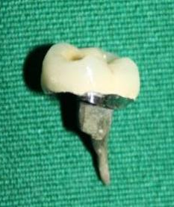
II. Intra coronal Retainers:
Inlays
Onlays
III. Radicular Retainer
Davis crowns
Richmond crown – Crown with post & core

Slide 21
B. Depending on the material used
Acrylic Resin
Acrylic Resin
All Ceramic
Combination of Porcelain + Metal
All Metal
Porcelain
Metal

Slide 22
Extracoronal Retainers
a. Complete Veneer Crowns:
FULL/COMPLETE VENEER CROWN

Slide 23
Partial Veneer Crown
Where only a portion of the clinical crowns is restored, not including the facial surfaces

Slide 24
Reverse three quarter crowns
II.Reverse three quarter crowns: Restores all the surfaces except the lingual surface used to conserve tooth structure in cases of mandibular posterior teeth especially with severe lingual inclination. Normally indicated in teeth with destroyed buccal surfaces and intact lingual surfaces.

Slide 25
Seven Eighth Crowns
III. Seven Eighth Crowns: Extensions of ¾ crowns as to include a major portion of the facial surface.
Encircles ⅞ of the gingival circumference.

Slide 26
One Half Crowns ( Mesial Half Crowns)
IV. One Half Crowns: Restore the occlusal and mesial surfaces as well as portion of the facial and lingual surfaces.

Slide 27
Telescopic Crowns
V. Telescopic Crowns: A full crown preparation with heavy reduction is made to follow the long axis of the tooth that is tilted and a coping is prepared to follow the long axis of the tooth preparation and the crown to be served as a retainer is fitted over the coping.

Slide 28
Intracoronal Retainer
Intracoronal Retainer: Obtain their retention and resistance to displacement from the intimate fit of the restoration within the confines of the coronal portion of the tooth.
Inlay
Onlay

Slide 29
a. Inlay:
Metal Inlay to restore a molar
Forces applied to an MOD inlay
produce stresses that tend to
separate the cusps.

Slide 30
b. Onlay: Modifications of the inlay to restore the occlusal surface of the tooth to prevent stress concentration.
Forces applied over a wider area is less destructive patterns.

Slide 31
Radicular Retained Restored
A post usually made of metal that is fitted into a prepared root canal of a natural tooth. When combined with an artificial crown/core, it provides resistance and retention to the restoration.

Slide 32
Connectors
Connectors: That portion of a FPD that unites the retainers and the pontic. Pontic
Rigid Non-rigid Loop connectors
Rigid Connector
Non-rigid connector- Precision attachment
- Stress Breakers

Slide 33
Cantilever Bridge:

Slide 34
Gingival retraction
DEFINITION: Gingival retraction or displacement is the deflection of the marginal gingiva away from the tooth. ‘tissue dilation’
The procedure used to facilitate effective impression making with intra-crevicular margins is gingival ‘displacement’ as opposed to ‘retraction’.
The goal of the procedure is to reversibly displace the gingival tissues in a lateral direction so that bulk of low viscosity impression material can be introduced into the widened sulcus and capture the marginal detail

Slide 35
Gingival retraction

Slide 36
PROVISIONAL RESTORATION
It is a transitional restoration that provides protection, stabilization and function before fabrication of definitive prosthesis. It may also be used to determine esthetics function and therapeutic effectiveness of the treatment plan

Slide 37
Classification of Fixed partial Dentures
It can be categorized as.
Simple.
Complex.
Depending on the number of the teeth to be replaced and the position of the dentulous space in the arch.

Slide 38
Simple Fixed Partial Dentures (Single Tooth)
When a single tooth is missing and the adjacent teeth are taken as abutments.
Does not include the missing of the canines.

Slide 39
Complex Fixed Partial Denture (One Tooth)
When only the maxillary/mandibular canines are missing and the central incisor, lateral incisor and the first premolar are taken as the abutment (i.e., secondary abutments are used.

Slide 40
Simple Fixed Partial Denture (Two Teeth)
It includes the missing of two teeth except the canines and the adjacent teeth are used as abutments.

Slide 41
Complex Fixed Partial Denture (Two Teeth)
Two teeth are missing and secondary abutments are also used depending on the edentulous span length and root configuration four abutments may also be used.
Canine may be missing

Slide 42
Complex Fixed Partial Denture (More than 2 teeth)
There are more than 2 teeth missing, but the canines are present and used as abutments with/without secondary abutments, depending on the span of edentulous space.

Slide 43
Complex Fixed Partial Dentures (Pier Abutment)
When there is edentulous space on either side of the abutment tooth. According to the location of the edentulous space, rigid or non rigid connectors may be used.

Slide 44
Other Terminologies
Laminates: They are veneer restorations that restore the facial surface of a tooth for esthetic purposes.
Fabricated from resin or Dental porcelain.
Fabricated by Direct or Indirect methods.
Only the facial surface is reduced and laminated.

Slide 45
Resin Bonded Restorations: are cast metal partial veneers that are bonded to etched enamel.
Maryland Bridges:

Slide 46
Rochete Bridge: A resin bonded bridge incorporating holes within the metal framework and lutes to the lingual aspect of teeth adjacent to an edentulous space that replaces or more teeth.

Slide 47
TAKE HOME MESSEGE / FOR THE TOPIC COVERED (SUMMARY)
Understanding of the various terminologies is important

Slide 48
REFERENCES 1. Rosenstiel S F et al : Contemporary Fixed Prosthodontics, 4th edn Missouri, Mosby Inc, pg 513 2. Shillingburg H T et al : Fundamentals of fixed prosthodontics,ed 4, Chicago , Quintessence Publishing, pg 485 3. Tylman SMalone W. Tylman's Theory and practice of fixed prosthodontics. 8th ed.

Slide 49
Question & Answer Session
Students should be given opportunity to ask question for clarifying for their understand/ confusions. Teachers must spend 5-10 minutes for this to improve the output.

Slide 50
THANK YOU

